Slide 1
Bell Let’s Talk Day
Bell Let’s Talk launched in 2010 with a focus on building awareness, acceptance and action towards mental health.
Since then Canadians have taken the conversation around mental health to remarkable heights, making it clear that mental health matters.

Slide 2
Bell Let’s Talk Day
On Wednesday, January 29th Bell will donate 5 cents for every text, call, tweet, social media video view, and use of their Facebook frame or Snapchat filter.
To find out where the money raised since 2010 has gone, follow this link:
https://letstalk.bell.ca/en/results-impact/#funds

Slide 3
Mental Health in the Workplace
Information here is based on…
“Hazard is a Hazard” developed by the Canadian Mental Health Association and the Manitoba Federation of Labour Occupational Health Centre
“Mental Health First Aid” developed by the Mental Health Commission of Canada
Guarding Minds at Work, Canadian Mental Health Association, and the Mental Health Commission of Canada have also been borrowed from heavily for this presentation.

Slide 4
Mental Health in the Workplace
Both workshops are scheduled for two days, this session will be run approximately 35 minutes, soooooooo……..…
Understanding that, this session will provide you with enough information to get started supporting mental health in your community and workplace, as well as a resource listing to get more information.

Slide 5
Mental Health in the Workplace… the Process
https://www.guardingmindsatwork.ca/

Slide 6
13 Factors: Addressing Mental Health in the Workplace
Organizational Culture
Psychological and Social Support
Clear Leadership & Expectations
Civility & Respect
Psychological Demands
Growth & Development
Recognition & Reward
Involvement & Influence
Workload Management
Engagement
Balance
Psychological Protection
Protection of Physical Safety
https://www.mentalhealthcommission.ca/English/13-factors-addressing-mental-health-workplace

Slide 7
Identify Organizational Needs
Guarding Minds at Work survey
https://www.guardingmindsatwork.ca/
Self assessment from senior leadership and frontline perception surveys often produce different results

Slide 8
Determine Assessment Resources
Understand the tools you have:
What can they tell you?
How will you deploy them?
What actions are you prepared to take based on the results?
https://www.guardingmindsatwork.ca/about/about-resources

Slide 9
Identify Key Participants
Internal
Safety Committee
Senior Leadership
Union
Frontline Supervisors
Human Resources
External
https://letstalk.bell.ca/en/taking-positive-action
IBSPs (Made Safe)
MFL OHC
Canadian Mental Health Association
www.madesafe.ca/contact

Slide 10
Create a Communication Plan
Lunch and Learn
Brochures
Posters
E-mail
Mental Health Champion / Contact Person
Kahoot or Poll Everywhere contest
Staff meetings
https://www.guardingmindsatwork.ca/about/about-plan

Slide 11
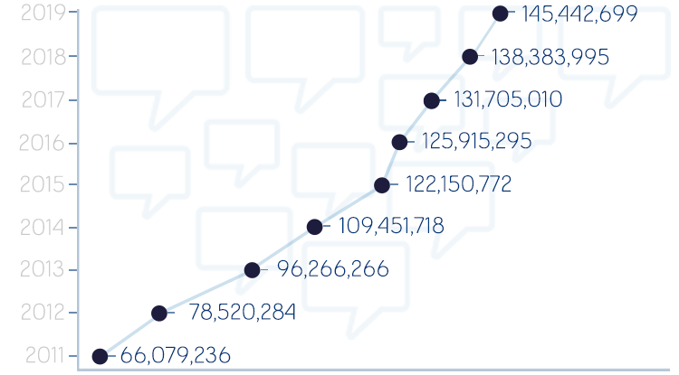
Launch the Plan!
1,013,915,275
Total number of interactions
Track Results
Take Action
(Plan-Do-Check-Act)
Evaluate
Maintain

Slide 12
Mental Health First Aid
Prevention and crisis intervention are equal partners
Contact Bryan Wall at St. John’s Ambulance Manitoba for local training (bryan.wall@sja.ca)
If a heart surgeon walking down the street sees someone having a heart attack, they don’t perform surgery they perform CPR
https://www.mhfa.ca/

Slide 13
Mental Health First Aid
Empathy vs. Sympathy
Brene Brown
Empathy drives connection
Take another’s perspective
No judgement!
Recognize others’ emotions
Communicate it
https://www.youtube.com/watch?v=1Evwgu369Jw

Slide 14
Mental Health First Aid
Five Basic Actions of Mental Health First Aid
A
L
G
E
E
Assess the risk of Suicide or harm
Listen non-judgementally
Give reassurance and information
Encourage professional help
Encourage other supports
https://www.thenationalcouncil.org/wp-content/uploads/2013/10/NC-Mag-MHFA-Origami-Insert.pdf

Slide 15
Mental Health First Aid
https://www.youtube.com/watch?time_continue=166&v=25uoUwAXC6w&feature=emb_title
www.mentalhealthcommission.ca

Slide 16
What Can We Do Today?
https://www.youtube.com/watch?time_continue=1&v=2OynJJOclGw&feature=emb_title

Slide 17
What Can We Do Today?
https://www.youtube.com/watch?v=THLOJG8zdR8&feature=emb_title

Slide 18
What Can We Do Today?
https://www.youtube.com/watch?time_continue=2&v=6Ou2oAIVx2g&feature=emb_title

Slide 19
What Can We Do Today?
https://www.youtube.com/watch?time_continue=7&v=Xq6eHENKKHw&feature=emb_title

Slide 20
What Can We Do Today?
https://www.youtube.com/watch?time_continue=4&v=YVCCRxJKsx8&feature=emb_title

Slide 21
Additional Resources - Substance Abuse
inspirebyexample.ca
National Geographic Drugs Inc. (TV Show)
www.catie.ca
This AMERICAN Life (opioid crisis - Podcast)
Manitoba Addictions Line 1-855-662-6605
Rosare House Addiction Centre 204-623-6425 (The Pas - 4 week non-residential program)
CODI - Co-occurring disorder initiative (WRHA referral need, symptoms evident)
Red Road lodge - 47 units clean space
St Raphael Wellness Center 204-956-6650 - 225 Vaughn Street (Not faith based, non profit)
Addictions Foundation of Manitoba - afm.mb.ca #204-944-6200
Youth Addictions centralized Intake Service 1-877-710-3999
MB opioid Support & Treatment 204-944-7070
RAAC-RAAM (817 Bannatyne, Tue, wed, Fri 1-3pm) (146 Magnus Tue, wed, Fri, 1-3pm)
AA (Wpg) Tues wed Friday 1-877-254-3348

Slide 22
Additional Resources - Mood Disorders
Apps
lift (coach me)
What’s Up
happify
DAY One
Sleep bug (sleep sounds)
MOVIES
Silver Lining Playbook
The Grizzlies (Inuit isolation suicide causes)
OTHER RESOURCES
Positive Psychology (Martin Seligman)

Slide 23
Additional Resources - Crisis
CRISIS Stabilization unit 1-888-482-5361 204-482-5361
Interlake Eastern Regional 24 hr, crisis line 2044825419, 1-866-427-8628
NON Crisis intake: 18667576205
Mobile CRISIS Services 204- 482-5376 1-877-499-8770
Grace Hospital psych unit 5 North
SCE LIFE WORKS (530/549 century) 204- 775-9402
Community mental health intake 204-785-7752 1-816-757-6205
Klinic Crisis Support 1-877-435-7170
CMHA 8 week program for families 204-982-6100
Bannatyne Center (HSC) 817 Bannatyne (24/7 Walk in)
Base for mobile crisis team (gov.mb.ca 204-940-1781)
Manitoba Suicide Line (Reason to Live) 1-877-Help-170 1-877-435-7170
Manitoba Farm & Rural Support Services 1-866-367-3276 (10AM-9PM)
First Nations + Inuit Hope for Wellness line 1-855-242-3310
CBTI - 204-982-3810 (paramedical benefit)
WRHA.mb.ca (adult mental health)
Mood disorder association of MB 1-800-263-1460

Slide 24
Additional Resources - Anxiety
Apps
Breathe
Unusual Breathing (by Saagra)
Self Help for Anxiety Management (SAM)
WORRY BOX
CALM
Headspace*
The Mighty
BOOKS
J. Edmund and Bourne-the anxiety and phobia workbook
The Feel Good Handbook (David Burns)
Don't Sweat the small stuff (Richard Carlson)
Power of No (Jamest Claudia Altucher)
Monkey Mind (Daniel Smith)
Why Zebras Don't get ulcers (Robert Sapolsky)

