Slide 1
MADE SFE
Machine Safety and North Forge

Slide 2
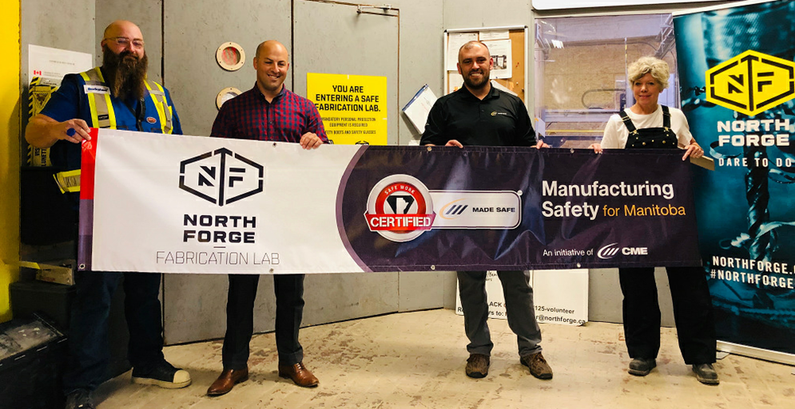

SAFE Work Certified!!!

Slide 3






SAFE Work Certified companies

Slide 4

Machine Guarding and You!
Who
What
When
Where
Why
How
machine guarding
Notes:
The hazards ide

Slide 5
Who is Machine Guarding?
We’re each responsible for machine safety.
Whether it’s your finger, eye, or process… or your neighbours!
Notes:
We’re all responsible for machine guarding!
The hazards ide

Slide 6
Who is REALLY Responsible for Machine Guarding?
LOOK REALLY CLOSELY, RIGHT HERE
Notes:
Its you!!! You’ve got your hands on the hazard, your face in the line of fire, you need to identify the risks!
The hazards ide

Slide 7
What is Machine Guarding?
From the CSA Standard Z432 Safeguarding of Machinery:
  “… protective measures consisting of the use of specific technical means, called safeguards (guards, protective-devices), to protect workers from hazards that cannot be reasonably removed or sufficiently limited by design.”
Notes:
The hazards ide

Slide 8
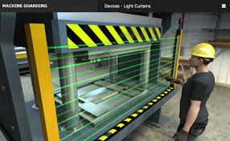
What is Machine Guarding?
Adjustable guard - a fixed guard that is adjustable as a whole or that incorporates adjustable parts. The adjustment to the guard remains fixed during operation.
Fixed distance guard
Fixed guard - a guard kept in place requiring tools for the removal or opening.
Interlocked guard
Movable guard - a guard connected by mechanical means (e.g., hinges or slides) to the machine frame or an adjacent fixed element. It can be opened without the use of tools.
Self-closing guard - movable guard operated by a machine element (for example a moving table) or by the workpiece or a part of the machining jig.
Notes:
The hazards ide

Slide 9
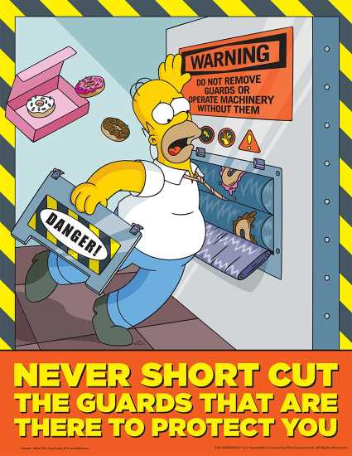
When is Machine Guarding?
Prior to commissioning the equipment.
Review prior to starting a new process
Review after making machine modifications
Review following internal or external incidents

Slide 10
Where is Machine Guarding?
At the Source
Along the Path
At the Operator

Slide 11

Why is Machine Guarding?
Moving parts (e.g., entanglement, friction, abrasion, cutting, severing, shearing, stabbing, puncturing, impact, crushing, etc.)
Energy
Heat or cold
Noise
Vibration
Radiation
Gas or liquid under pressure
Psychosocial hazards
Notes:
We’re all responsible for machine guarding!
The hazards ide

Slide 12
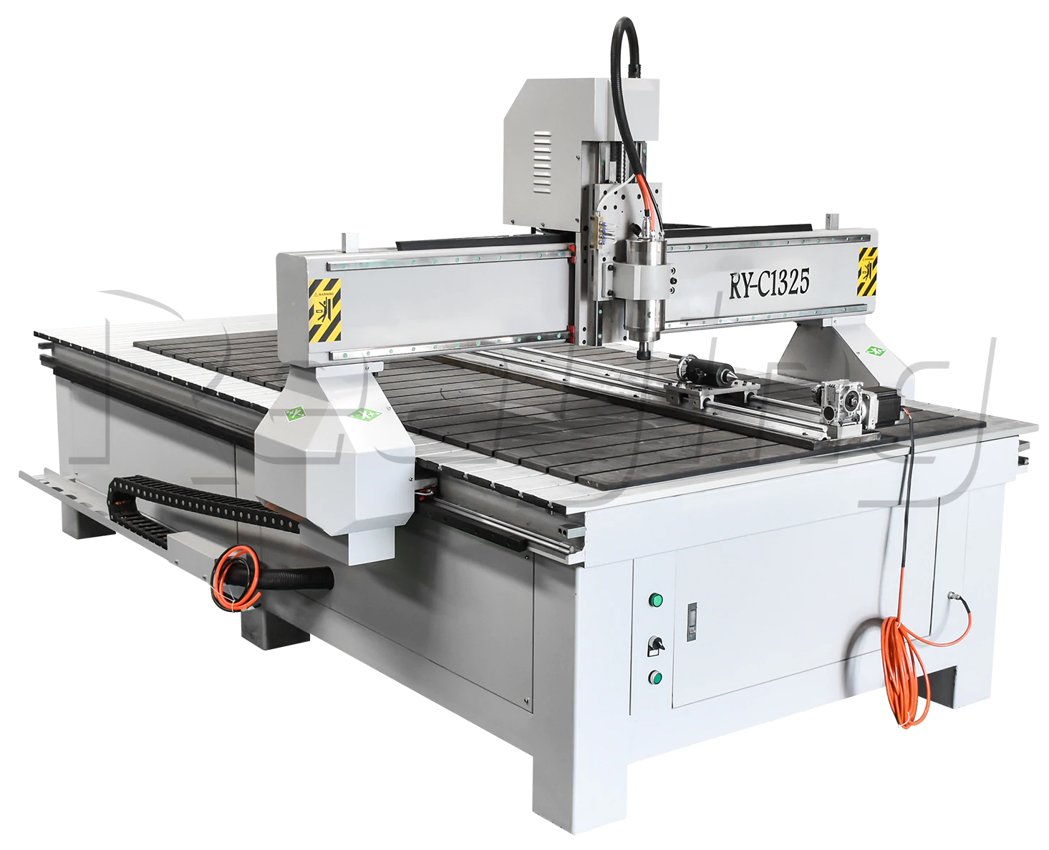
How to Guard Our Machines?
Elimination - remove the hazard from the workplace | Process design, redesign or modification including changing the layout to eliminate hazards Eliminate or reduce human interaction in the process Automate tasks, material handling (e.g., lift tables, conveyors, balancers), or ventilation

Slide 13
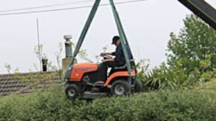
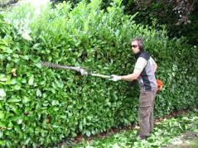
How to Guard Our Machines?
Substitution - replace hazardous materials or machines with less hazardous ones | Machines that have energy containment Machines with lower energy (e.g., lower speed, force, pressure, temperature, amperage, noise, or volume)

Slide 14
How to Guard Our Machines?
Engineering Controls | Installation of safeguards (see types above) Installation of complementary measures such as emergency stop devices, platforms, or guardrails for fall protection

Slide 15
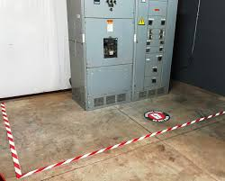
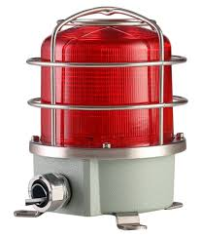
How to Guard Our Machines?
Systems that increase awareness of potential hazards | Lights, beacons, strobes Backup alarms, notification systems Hazard warning signs, placards, labels

Slide 16

How to Guard Our Machines?
Administrative Controls - controls that alter the way the work is done | Training Housekeeping processes Safe job processes, rotation of workers, changing work schedules

Slide 17

How to Guard Our Machines?
Personal Protective Equipment - equipment worn by individuals to reduce exposure | Protective eyewear and faceshields Hard hats Hearing protection Hand protection Protective footwear

Slide 18

The Next Steps?
Machine Safety Audit Checklist
Plant Level Hazard Assessments
Machine Commissioning Process
Job Hazard Analysis

Slide 19
Thank you!

